Slide 1

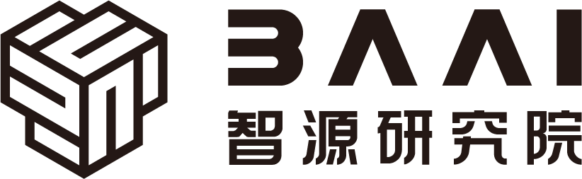

Hardware and Software Fundamentals of
Intelligent Computing
Systems

Slide 2
Lecture 19: Overview of AI Compilers
Notes:
为什么需要AI编译器？
* 内存墙 (Memory Wall) 危机：近 20 年来，硬件算力（FLOPS）的增长速度远超内存带宽的增长，导致 AI 模型（特别是大模型推理）在执行时受限于内存读写而非计算能力 。
* 算子爆炸问题：深度学习框架中的算子数量呈指数级增长（PyTorch 算子已达数千个），依靠硬件厂商（如 NVIDIA cuDNN）手工编写和优化每一个算子变得不再现实 。
* 传统框架的困境：动态图（Eager Mode）易于调试但存在 Python 解释器开销大、难以进行全局图优化等性能瓶颈；静态图（Graph Mode）性能高但缺乏灵活性 。

Slide 3
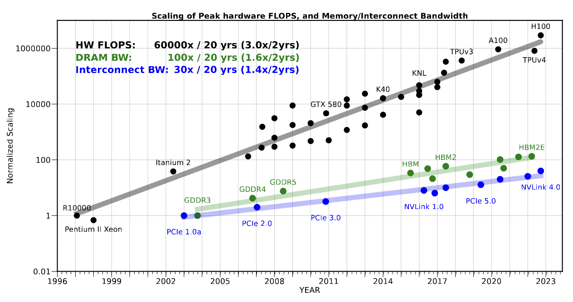
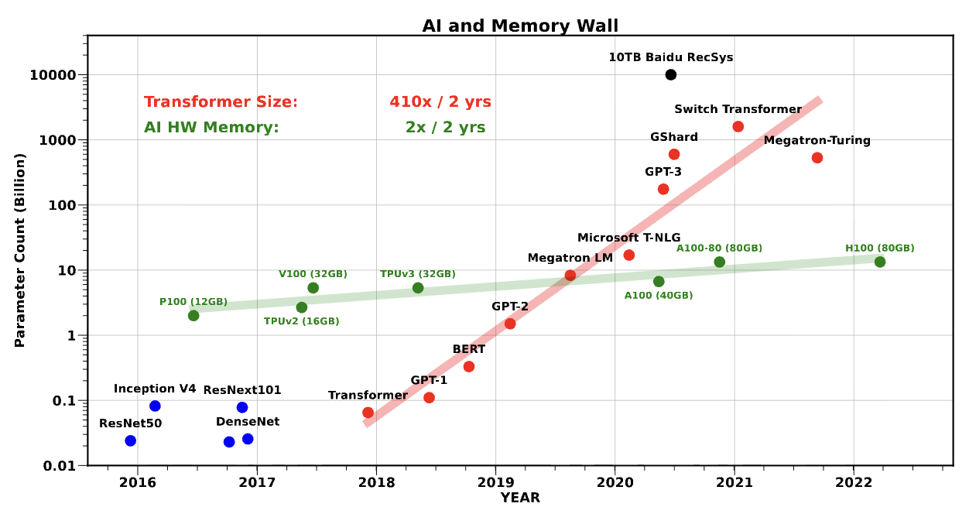
Memory Wall Crisis and Idle Compute
Imbalanced Hardware Development:
  Over the past 20 years, peak server compute has grown 3.0 x every two years, while DRAM memory bandwidth has only grown 1.6 x.
Large Language Model (LLM) Performance Bottleneck:
  In autoregressive decoding operations, arithmetic intensity is extremely low, GPU massive tensor cores are left data-starved.
The Only Way Out:
  Cannot rely solely on arithmetic instructions; compiler-level scheduling is needed to merge multiple memory accesses and reduce intermediate activation tensor reads/writes toHBM .

Slide 4
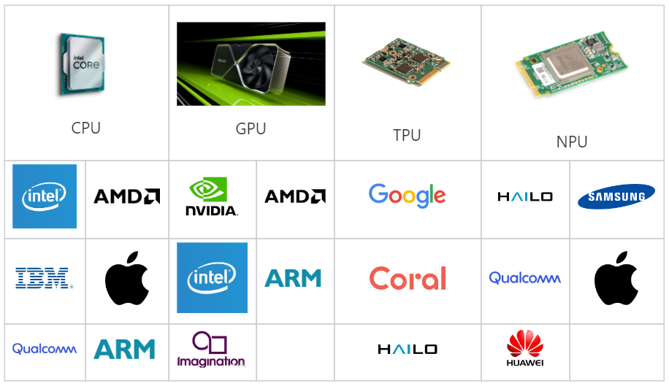
Operator Explosion and Hand-written Kernel Crisis
Operator Scale is Massive:
  In PyTorch framework, the number of core operators has exceeded 1200, including all overloads and variants reaching 3500+
Enormous Implementation Matrix:
  Over a thousand operators × multiple numeric types × fragmented target hardware (GPU, TPU, NPU）
Unsustainable Manual Optimization:
  Relying on hardware vendor engineers to hand-write CUDA C++ kernels to cover all combinations is not practically feasible at engineering scale
OperatorCategory | NumberofBaseOperators
TensorIterator(Pointwise&Reduction) | 505
Fixed(Fixed-dimensionComputation) | 273
Convolution(ConvolutionVariants) | 67
Pooling/BatchNorm | 57
Private/Foreach | 233

Slide 5
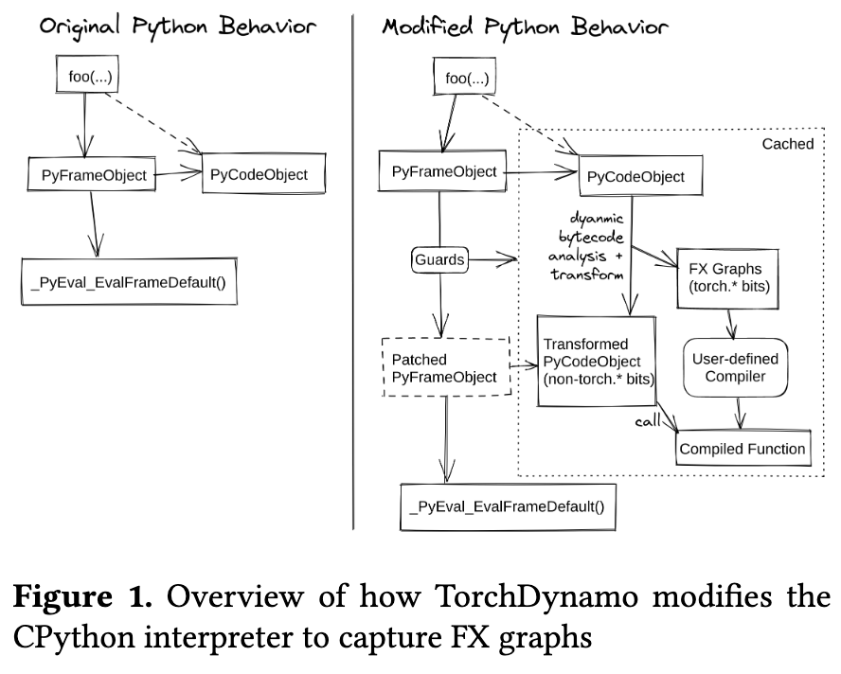
The Dilemma of Traditional Frameworks
Eager Mode Performance Bottleneck:
  Highly flexible and easy to debug, but each operator call must traverse the massive Python interpreter overhead; the framework can only see a single operator, losing the ability for global graph optimization (e.g., operator fusion).
Graph Mode Lacks Flexibility:
  To eliminate interpreter overhead, users must sacrifice Python native control flow, even requiring code rewrites.
Recompilation Problem:
  Early static tracing systems easily trigger repeated recompilation when facing dynamic shapes, negating the benefits of low-level optimizations.

Slide 6
AI Model Development Facing Crises
Shift of the Core Contradiction in Computing:
  As large model parameters scale beyond trillions, the bottleneck shifts from pure algorithm design to the gap between hardware physical limits and software framework abstractions.
Three Intertwined Underlying Crises:
  Deep learning systems currently face "Memory Wal" problem, "Operator Explosion" problem, and the traditional execution mode dilemma between eager and graph modes problem.
AI The Rise of Compilers:
  AI Compiler technology has evolved from early graph optimization auxiliary tools into the core infrastructure that dominates computation graph capture, hardware scheduling, and machine code generation.

Slide 7
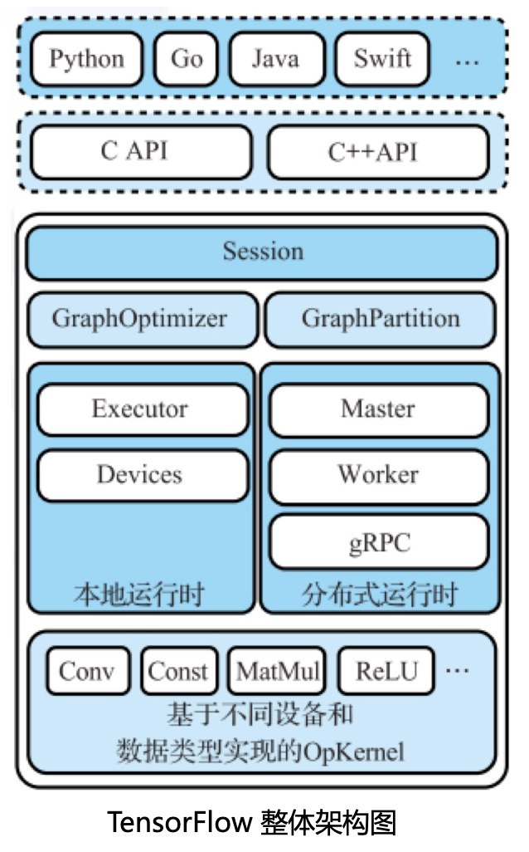
TensorFlow Introduction
Multiple Language Bindings
C/C++ Interface
TensorFlowBackend
  Runtime, Framework, Computation Graph, Graph Optimization, Compute Kernels, Compute Nodes
Different underlying hardwareOpKernel have different implementations
  CPU, GPU, Deep Learning Processor

Slide 8
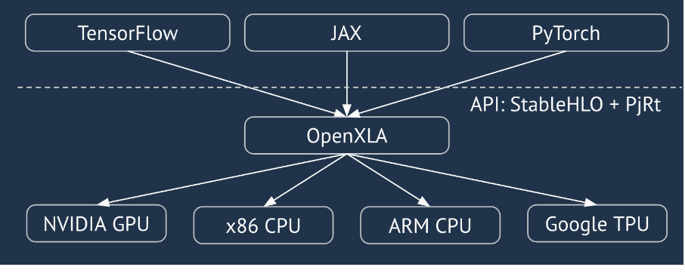
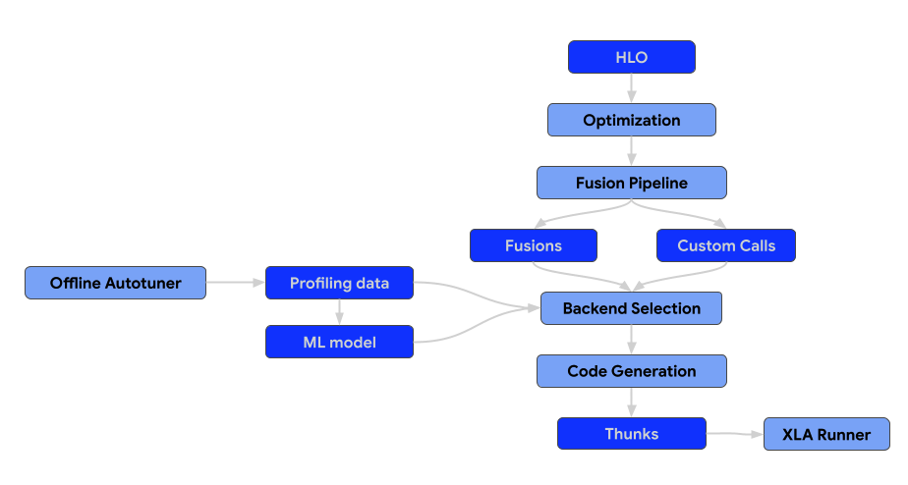
TensorFlow XLA Overview
Core Objective:
  Targeting TPU/GPU and other hardware platforms, performing extreme low-level hardware graph fusion on highly regular static computation graphs .
UnifiedFrontend-Backend Ecosystem:
  Aiming to provide PyTorch, JAX and TensorFlow with a unified high-performance backend featuring portability.
DesignGoals:
  Breaking free from frontend framework syntax constraints, building high-level graph abstractions to achieve mathematical semantic fidelity and global optimization.

Slide 9
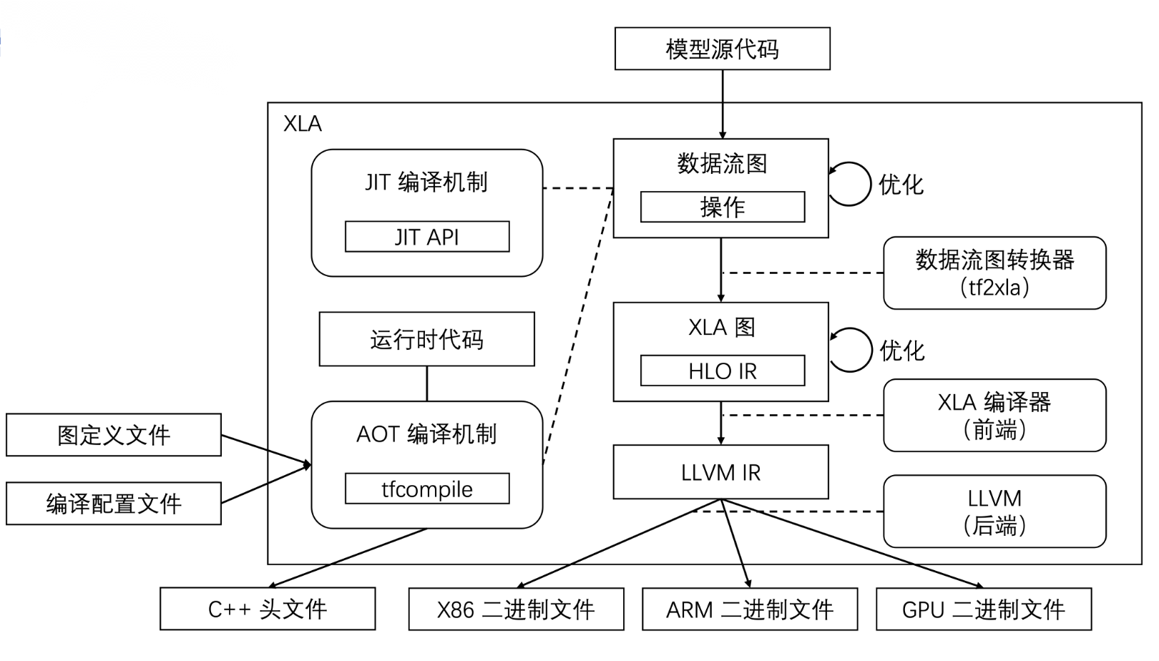
Multi-level IR Architecture and Graph Transformation
Hierarchical Lowering Mechanism:
  StableHLO (Cross-framework Protocol Layer) --> HLO (High-Level Optimizer Internal Representation) --> LLVM IR --> low-level machine code.
Hardware-Independent High-Level Graph Optimization:
  Performing algebraic simplification (Algebraic Simplifier, e.g., division to reciprocal multiplication), dead code elimination (CSE) etc..
HloRematerialization:
  Trading compute time for GPU memory space, proactively discarding inexpensive intermediate tensors and recomputing when needed, reducing peak GPU memory consumption for large models.

Slide 10
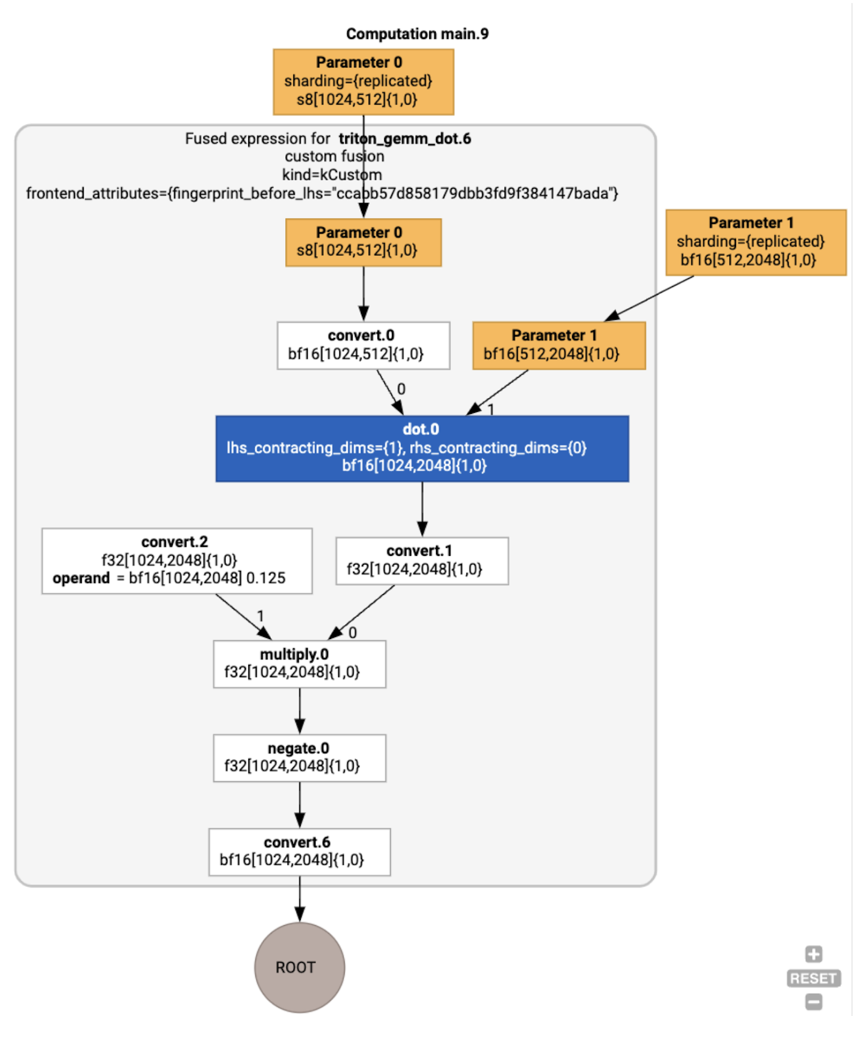
Core Optimization Technique: Operator Fusion
XLA can merge multiple HLO instructions and compile them into a single GPU Kernel, reducing kernel launch overhead.
inFusion Computation, intermediate temporary tensors typically do not need to be written back to off-chipHBM.
Data flows only within the GPU extremely fast registers or shared memory, bypassing memory access limitations.

Slide 11
XLA Optimization Pipeline
HLO Fusion Analysis
  kLoop (Loop Fusion): For element-wise operations with identical output shapes, chaining pure mathematical mappings per element and dispatching to parallel thread grids .
  kInput (Input Fusion): Allows reduction operators that significantly reshape data (Reduction) to pull upstream input operators for merging, mandating the reduction output as the computation endpoint .
  kOutput (Output Fusion): Specifically for merging high compute-density matrix multiplication operations with subsequent operators, maximizing cache utilization .
Hero Op Emitter Mechanism
  The compiler identifies the instruction with the greatest global performance impact and strictest scheduling requirements as the Hero Op，, which dominates the code generation strategy for the entire fused body.
  After emitter processing, it is converted to low-level LLVM IR, , and micro-architecture optimizations are performed based on specific hardware ISAs, including instruction pipeline scheduling and vectorization, ultimately generating executable PTX assembly or SPIR-V binary code .

Slide 12
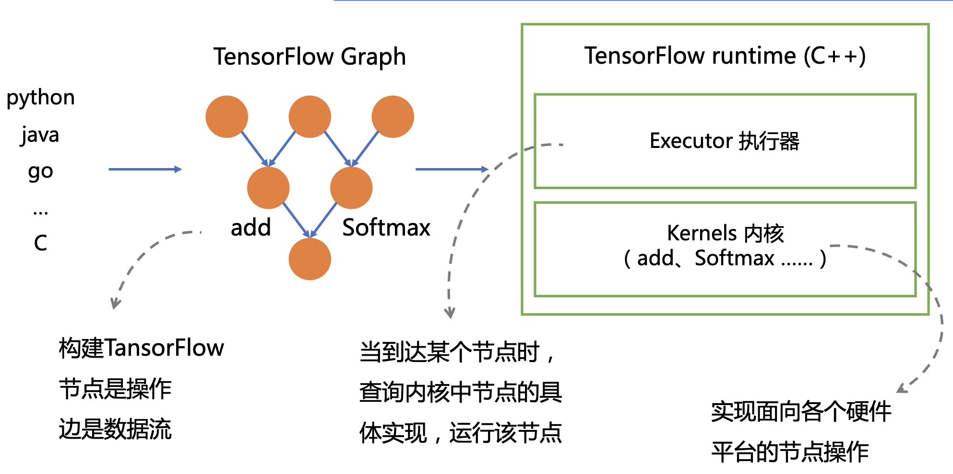
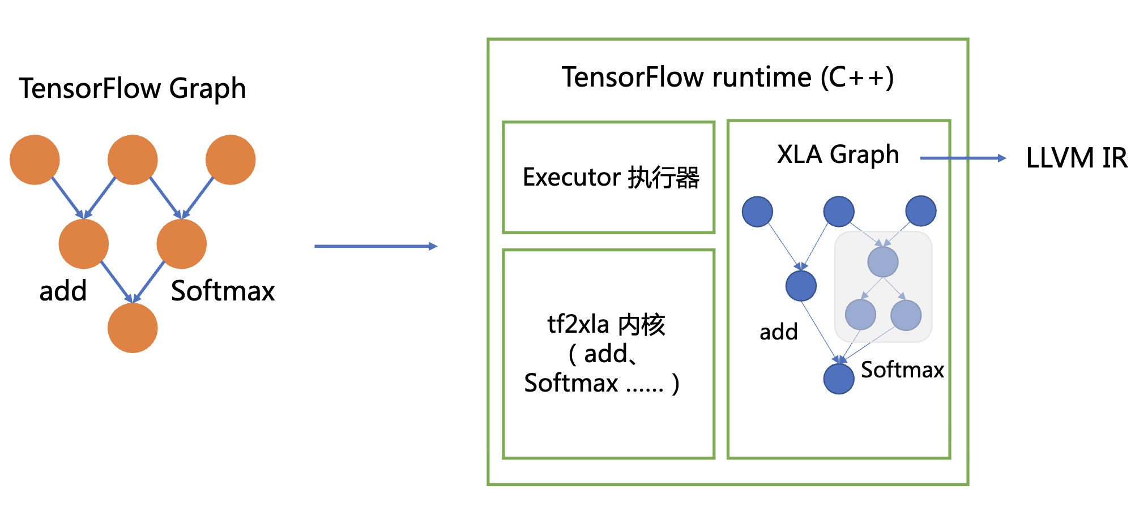
Using XLA to Accelerate TensorFlow

Slide 13
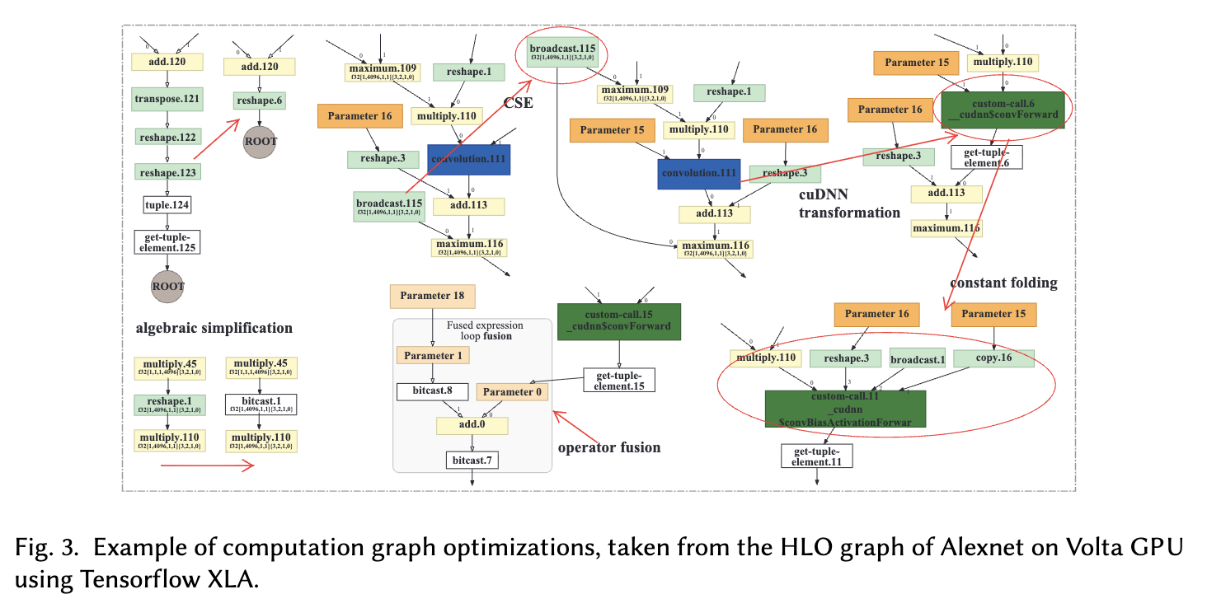
Example of optimizations using Tensorflow XLA

Slide 14
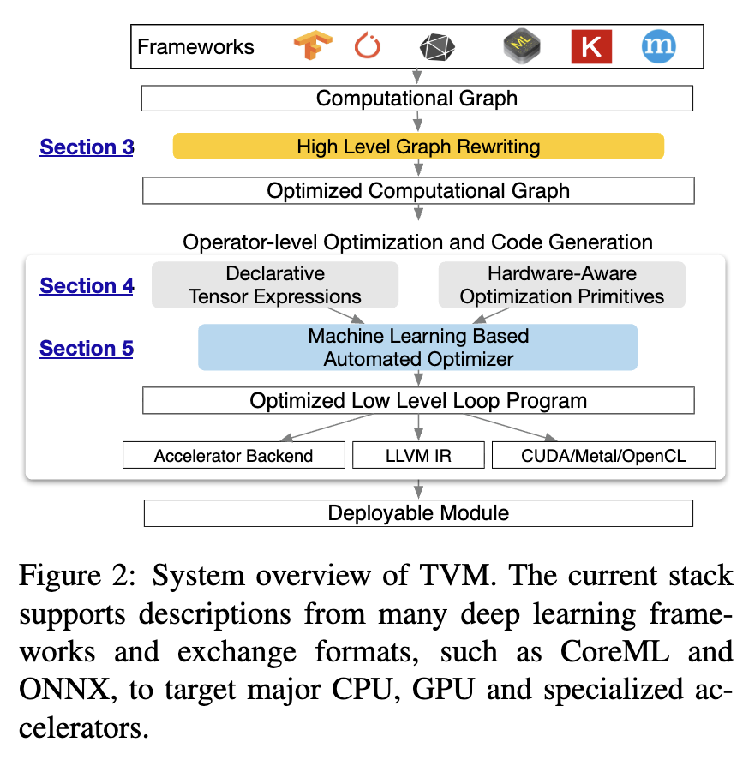
Apache TVM Overview
Addressing Full-Spectrum Hardware Fragmentation:
  XLA which targets cloud-scale clusters, TVM is committed to bridging the gap between CPU, ARM, GPU and various heterogeneous edge NPU architecture barriers.
Write once, run anywhere:
  Providing a unified compiler frontend framework, achieving seamless cross-platform high-performance deployment through hardware-specialized code generation.
Scheduling NP -Hard Challenge:
  Any tensor operation on specific hardware has nearly infinite loop unrolling and tiling strategy combinations, making it impossible to exhaustively find the optimal solution.

Slide 15
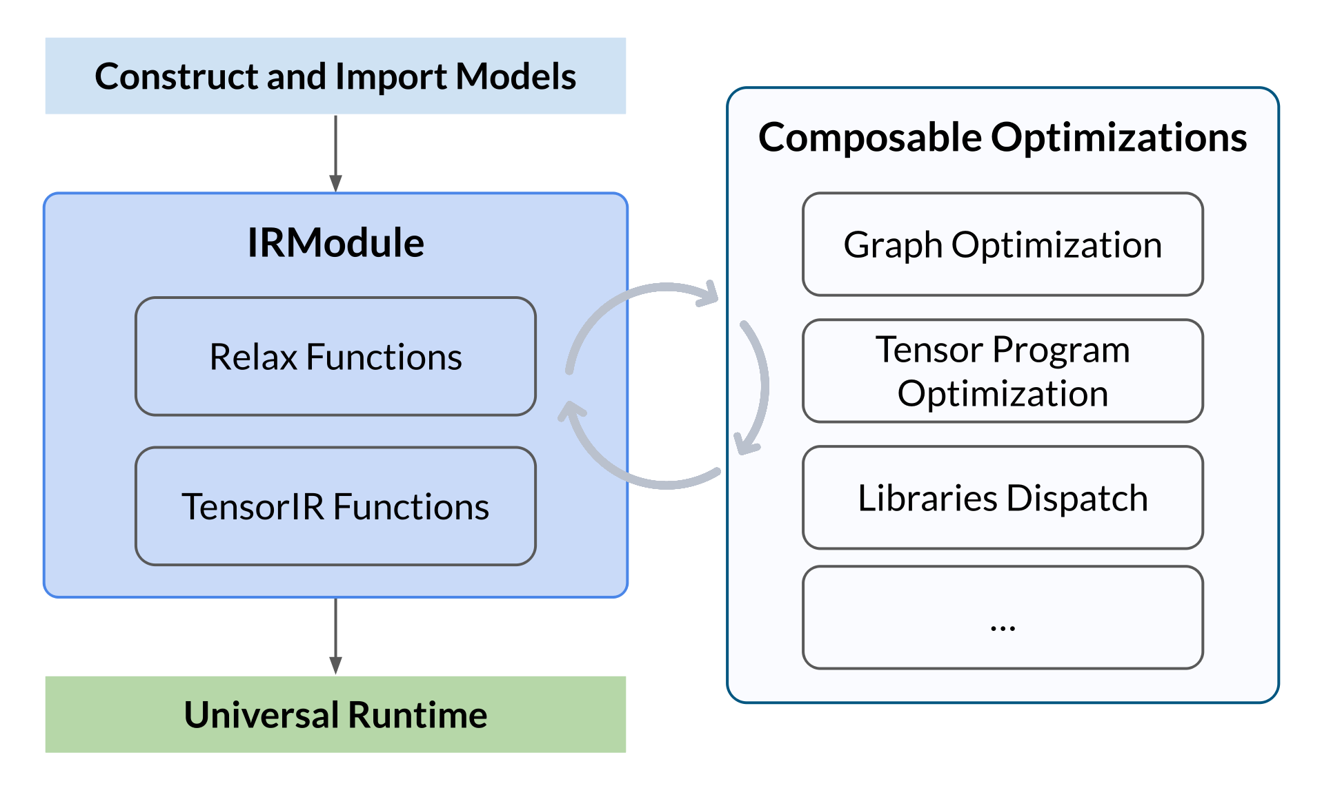
TVM Multi-level IR Architecture System
High-level Relay IR:
  Incorporating functional programming paradigms, managing coarse-grained dead code elimination, high-order operator fusion, and complex control flow graph optimization.
Low-level TIR (Tensor IR):
  Abandoning graph-layer concepts, translating operations into microscopic low-level nested loop structures, with fine-grained register and instruction mapping management .
TVM Unity and Relax Architecture:
  The next-generation system introduces symbolic shapes and allows high-level graph derivation and low-level loop primitives to coexist in the same module, enabling cross-level joint optimization.

Slide 16
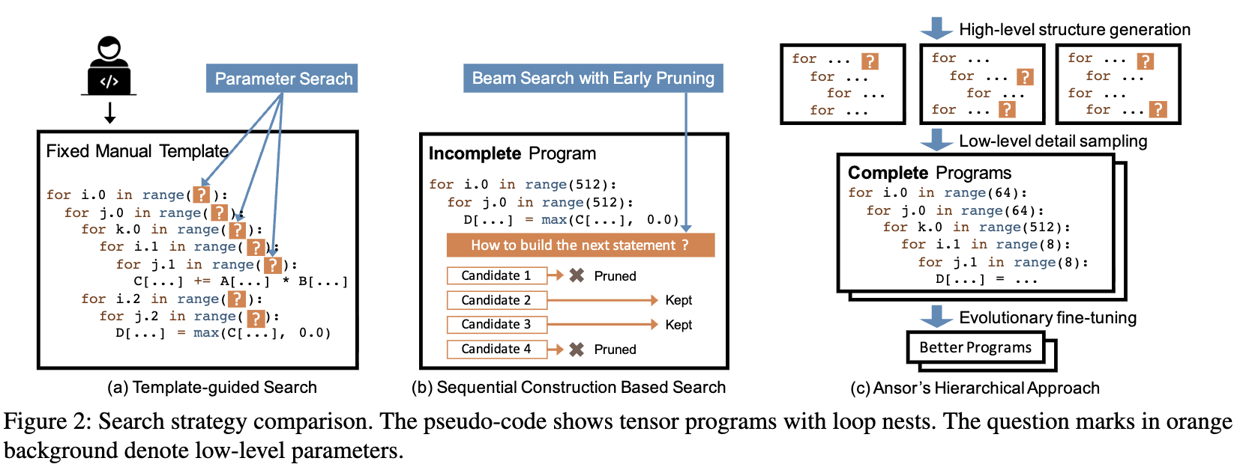
TVM Automated Scheduling
AutoTVM:
  Highly dependent on top hardware experts hand-writing scheduling templates; when encountering undefined new operators, development cost is very high.
Ansor (AutoScheduler) Architecture:
  Abandoning manual templates, automatically generating operator loop architecture frameworks from fundamental mathematical expression derivation rules.

Slide 17
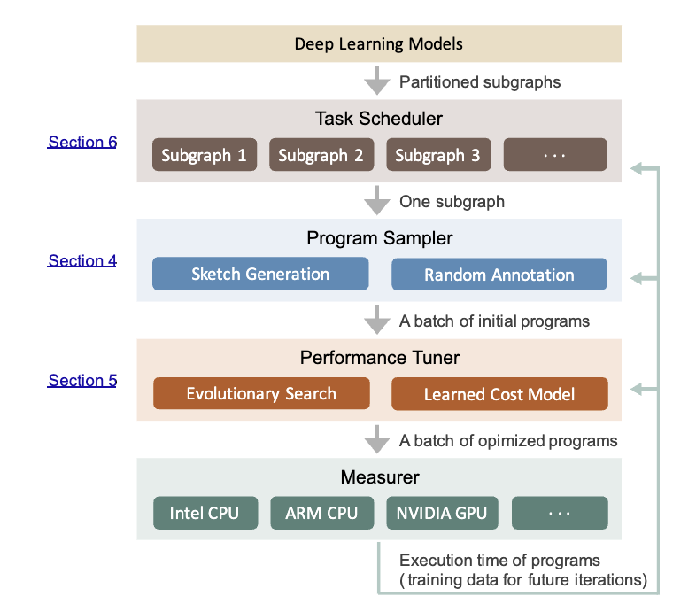
Ansor Hierarchical Search Space Construction
Sketch Generation: Ansor Constructing the program's macro-level skeleton by reverse topological traversal of the computation graph, recursively applying derivation rules.
Annotation Sampling: Building on sketches, Ansor performing random sampling in the annotation space to determine specific tile sizes, parallelization boundaries, loop unrolling limits, and other low-level configurations.
Introducing a machine learning GBDT cost model to rapidly predict and evaluate hardware throughput for scheduling strategies.
Employing evolutionary search algorithms: GBDT filters the Top-K Scheduling candidates and dispatches them to target hardware for actual benchmarking. Measured data is then used to fine-tune the GBDT model, progressively adapting it to the target hardware.

Slide 18
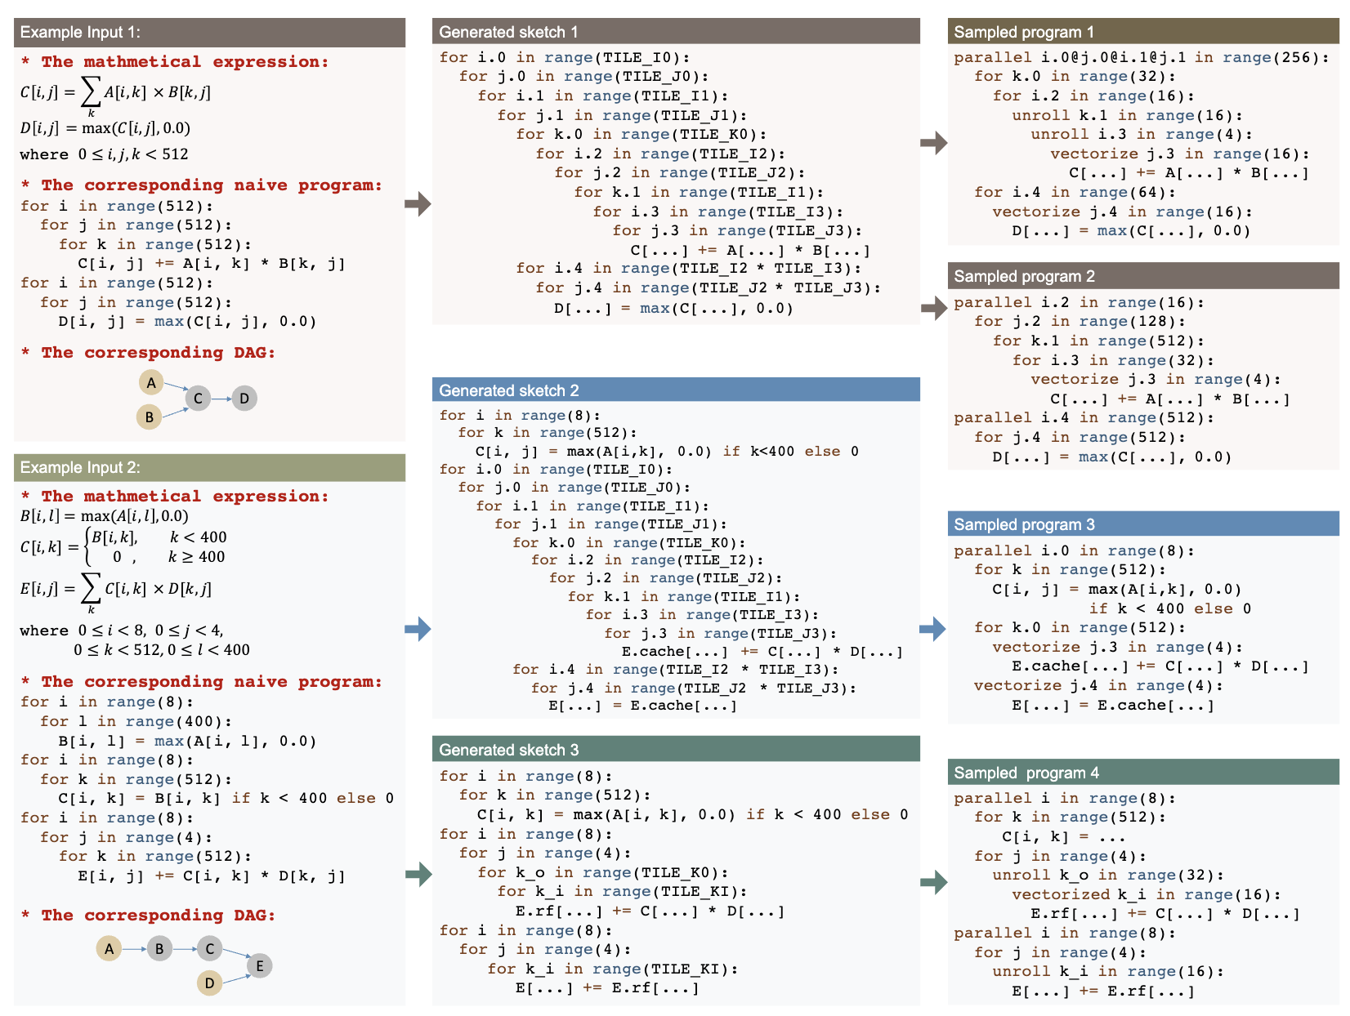
Examples of generated sketches and sampled programs

Slide 19
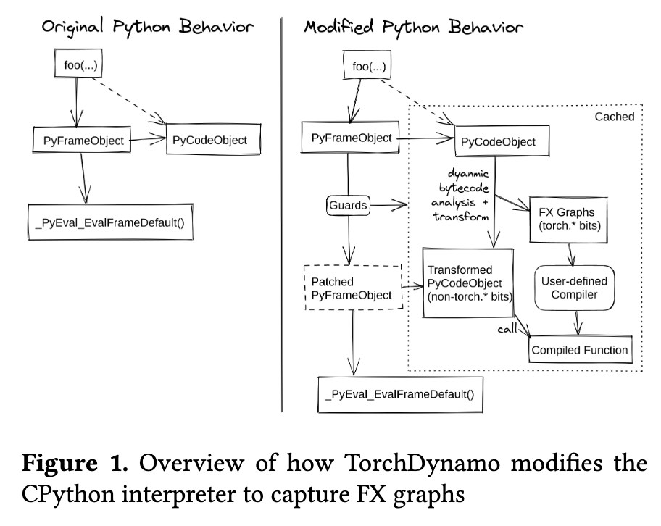
TorchDynamo Overview
Eager Mode Pros and Cons:
  PyTorch define-by-run mechanism is highly flexible and well-loved by researchers . However, the framework can only see one operator at a time, making cross-operator graph-level optimization (e.g., operator fusion, memory scheduling) difficult.
Compromises of Previous Approaches:
  TorchScript: Attempts static parsing of Python AST, facing“all-or-nothing” dilemma, easily failing because it doesn't support complete Python semantics .
  Lazy Tensors: High runtime overhead, delaying low-level kernel launch and causing frequent recompilation .
TorchDynamo Core Motivation:
  As a Python -level Just-In-Time compiler, the goal is to achieve Python graph compilation without sacrificing any PyTorch flexibility .

Slide 20
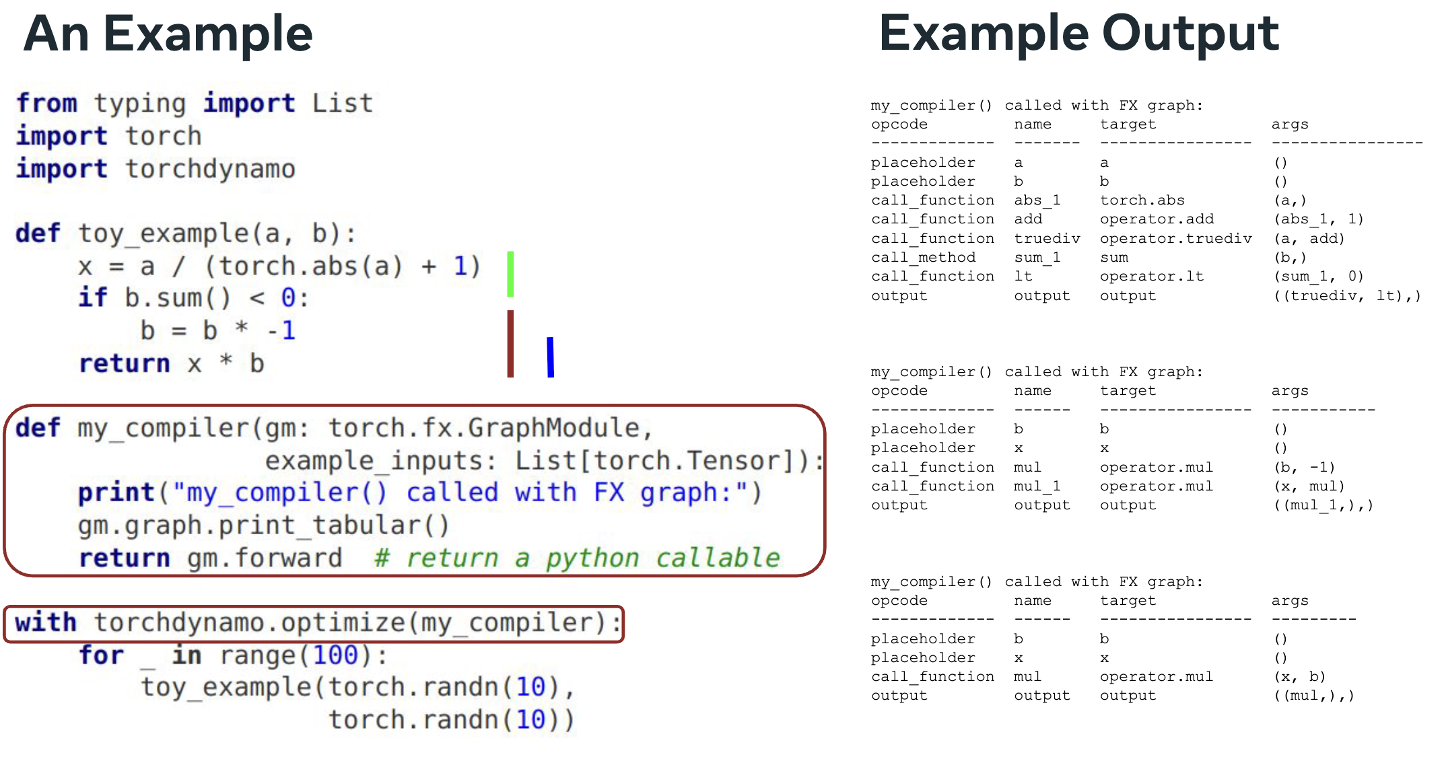
TorchDynamo Example

Slide 21
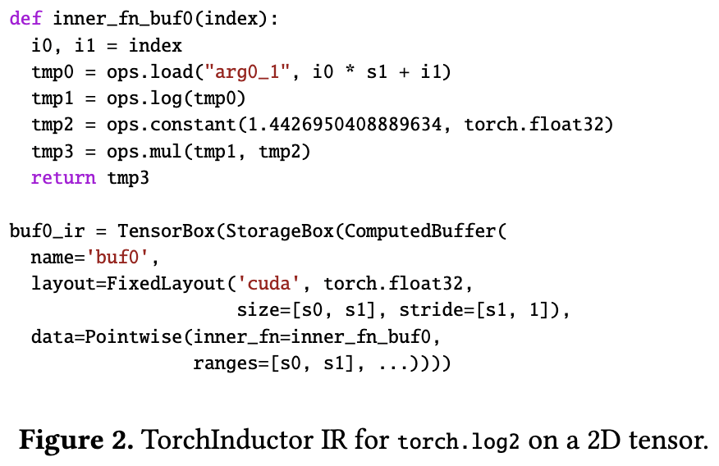
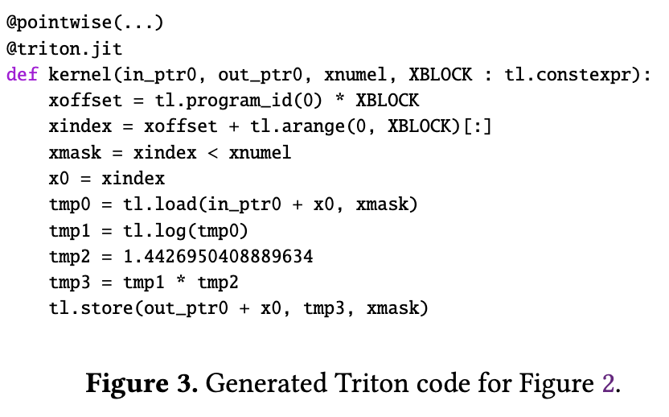
Frame Evaluation Bytecode Transformation
PEP 523 Extension Point:
  TorchDynamo delves deep into CPython internals, leveraging the PEP 523 -introduced frame evaluation API eval_frame .
DynamicInterpretation and Rewriting:
  in CPython to create PyFrameObject , TorchDynamo replaces the default interpreter loop, instead performing JIT compilation on the Python bytecode about to be executed JIT compilation .
FX Graph Extraction:
  By rewriting bytecode, PyTorch operation sequences are extracted as backend input (FX Graph).

Slide 22
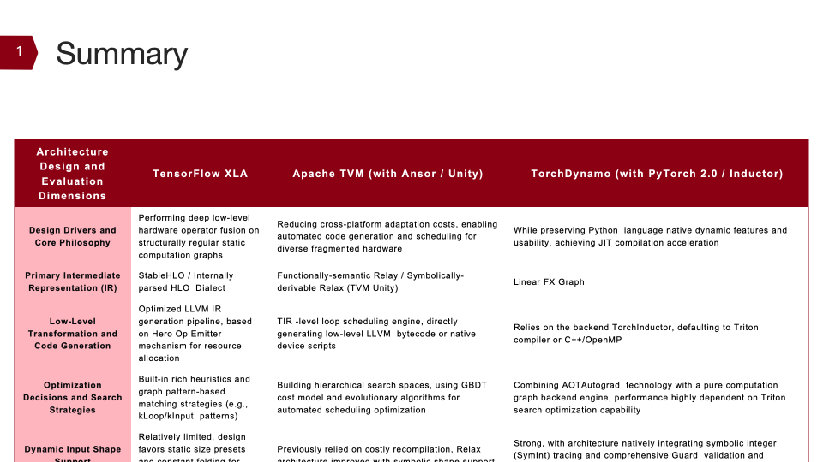
Solving Dynamism Issues

Slide 23

The Solution: FlagOS, a Unified AI Software Stack

Slide 24








https://space.bilibili.com/3546791834290849
https://github.com/flagos-ai
https://www.zhihu.com/people/95-22-20-18/posts
https://flagos.io/Home

Slide 25

Thanks for your time！

